Slide 1
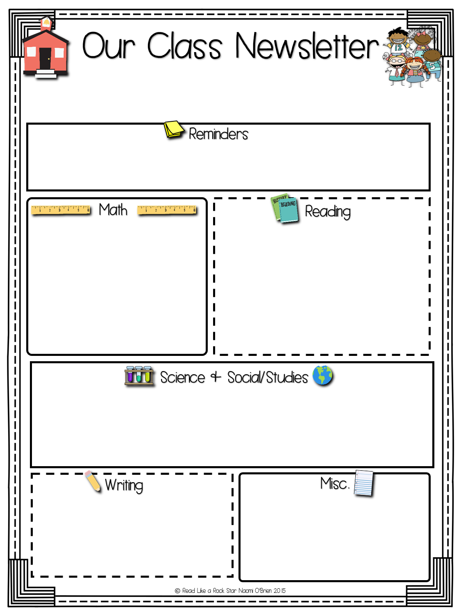
The Farrell Flyer
Week of: July 17, 2017
Please check and sign your child’s responsibility card each night and send it in each day.
The class will focus on mastering the ability to add and subtract numbers less than 20 using their preferred strategy.
We are finishing up the 5 Ws of reading and moving into identifying the Beginning, Middle, and End of a story.
The class will continue working with solids, liquids, and gases. We will talk about the properties of the three different states of matter.
We will learn about small moment writing. We will take an event and zoom in on one part of the event and focus on that moment in their writing.
Download the Specials calendar here! Specials Calendar

